Slide 1

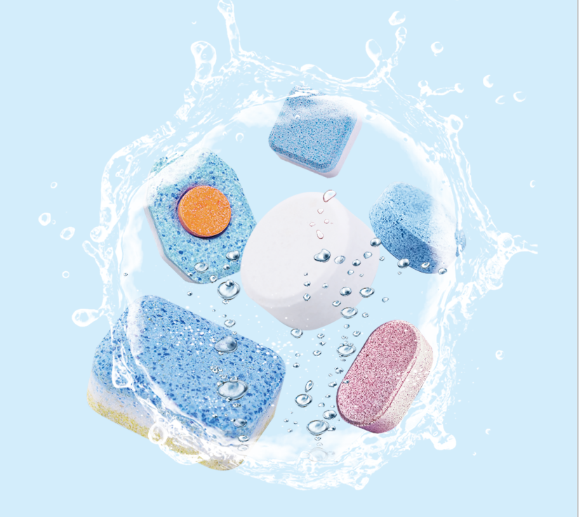
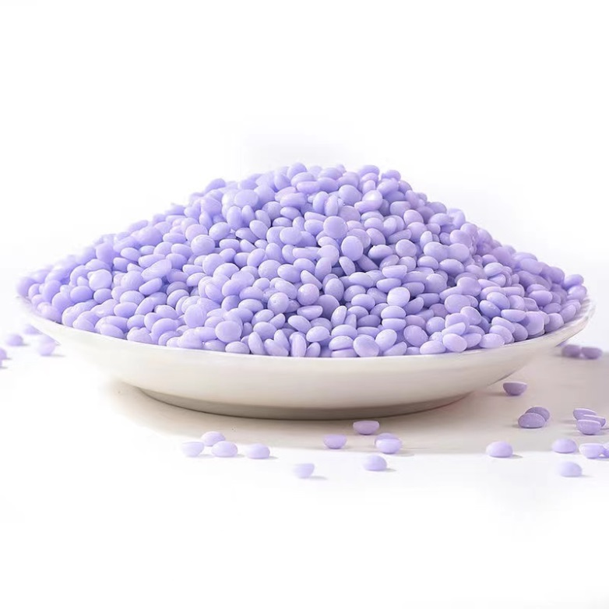
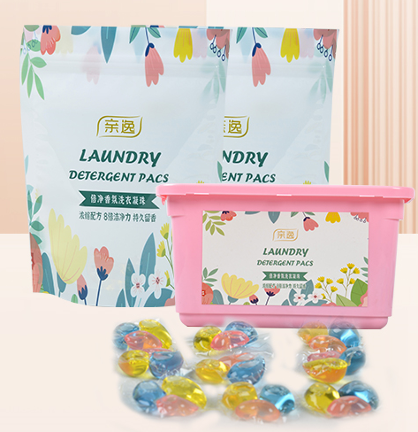
OEM\ODM Customization
Cleaning Tablets
Fragrance Beads
Laundry Pods

Slide 2
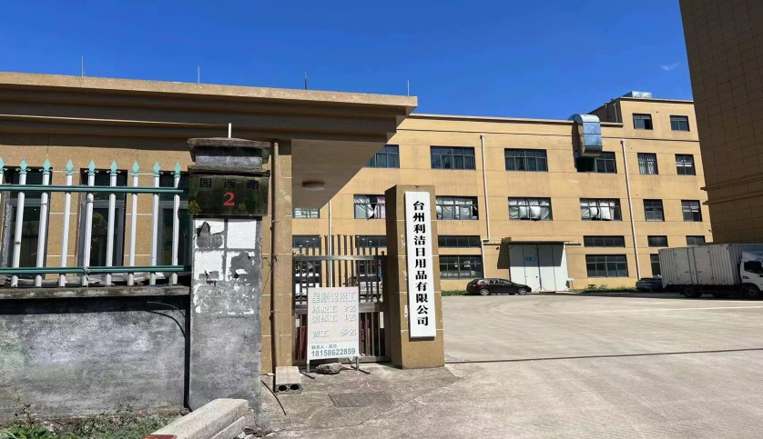
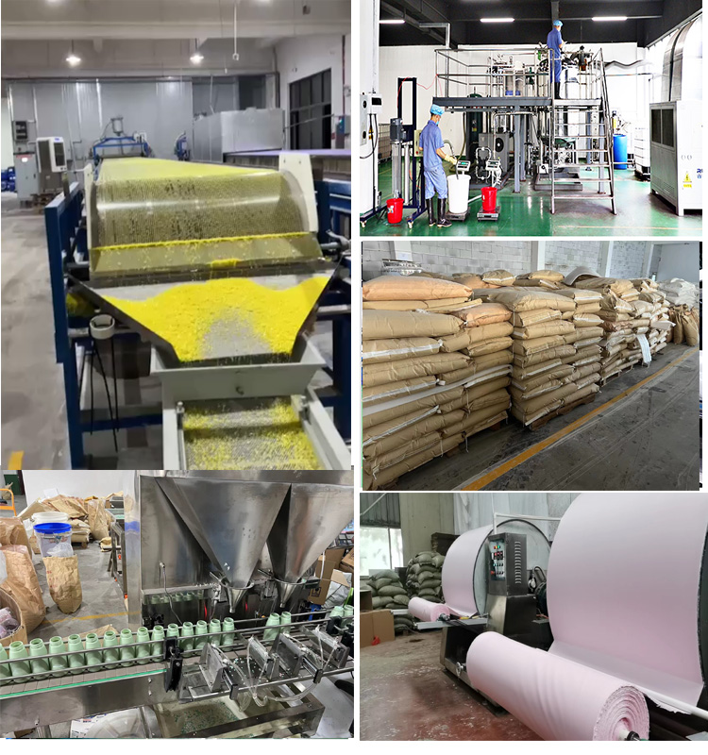
About
us
Factory Profile
About Us
Zhejiang Supershine Household Chemical Technology Co,. Ltd. is a well-known daily chemical manufacturer in China. Relying on the superior technical support of Beijing University of Chemical Technology, the factory has been intensively cultivating in the field of daily chemical and household cleaning products, with meticulously crafted products and the pursuit of excellence in quality. The factory currently has a standard standardized modern workshop and a full set of tablet pressing, granulation of fragrant beads and automatic filling production lines. The product range covers "household environment cleaning, clothing cleaning care, fragrance beads, special detergent for dishwashers" and other series. The series of products of its cross-border brand "oradess" are well received by major cross-border sellers. At the same time, it has also cultivated and shaped the domestic e-commerce and supermarket brand "Qinyi".
Create good products for customers, create a good life for employees, and develop together with partners!

Slide 3
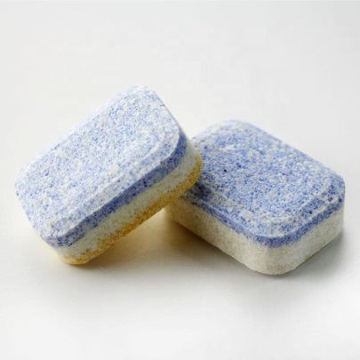
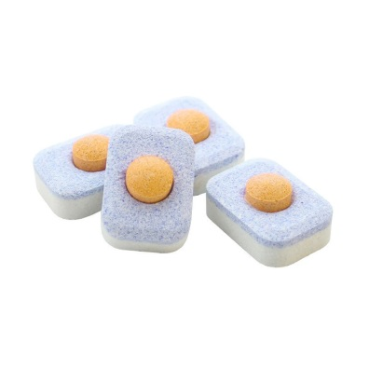
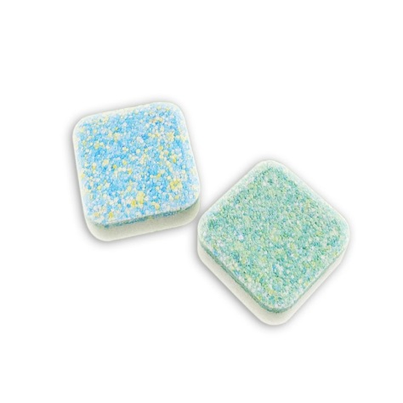
01
Product Introduction OEM Series
Name | Dishwasher Cleaning Tablets | Commodity attributes: Household cleaning - dishwasher detergent
Specification | 10 grams /15 grams /20 grams | Customizable: weight/ color/ content
Main Ingredient | Soda ash, sodium citrate, amino acid active agent, biological enzyme, etc.
Effect | Concentrated decontamination, water softening, bright tableware, odor removal, safe and no residue
Instructions | 1. After cleaning the food residue from the dishes, place the tableware according to the instructions of the dishwasher; 2. Remove the inner bag of the dishwashing block and put it into the slot; 3. Close the slot and start the dishwasher
Executive standard | Q\TLJ001-2018

Slide 4
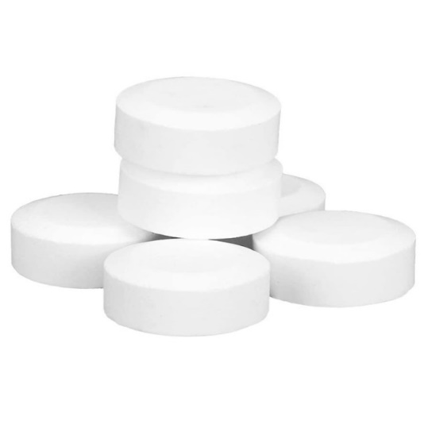
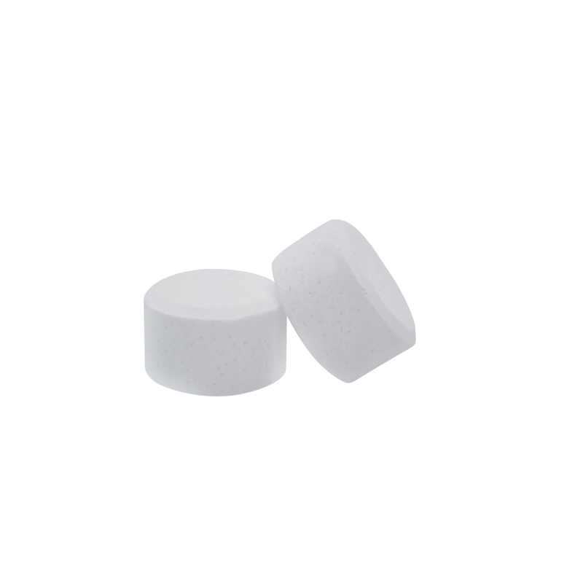
02
Product Introduction OEM Series
Name | Coffee Machine Cleaning Tablets |  | Commodity attributes: Household cleaning - coffee machine detergent
Specification | 2 grams per piece 10 pieces one box | 5 grams per piece 8 pieces one box | Customizable: weight/ color/ content
Main Ingredient | Citric acid, sodium percarbonate, maleic acid, sulfamic acid
Effect | Clean the coffee grease, clean the brewer of the coffee machine, protect the internal pipeline of the coffee machine
Instructions | Refer to the instruction manual of each coffee machine for operation

Slide 5
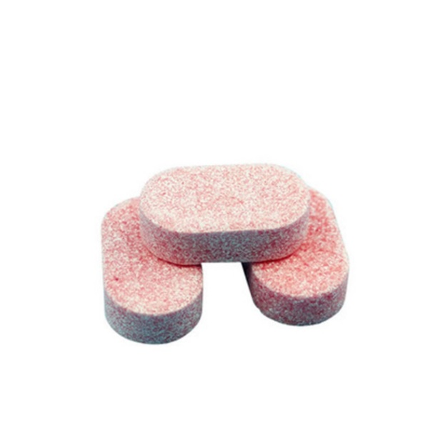
03
Product Introduction OEM Series
Name | Multi-effect Floor Cleaning Effervescent Tablet | Commodity Attributes Household Cleaning - floor cleaning tablets
Specification | 8 grams | Customizable: weight/ color/ content
Main Ingredient | Surfactants, biodegradable enzymes, bacteriostats, aromatic substances, etc.
Effect | Efficient cleaning, nourishing protection, antibacterial and stain removal
Instructions | 1. Take 2-3 tablets and dissolve in water 2. Immerse the mop completely in the solution 3. Cooperate with the mop to mop the floor
Executive standard | Q\TLJ015-2020

Slide 6

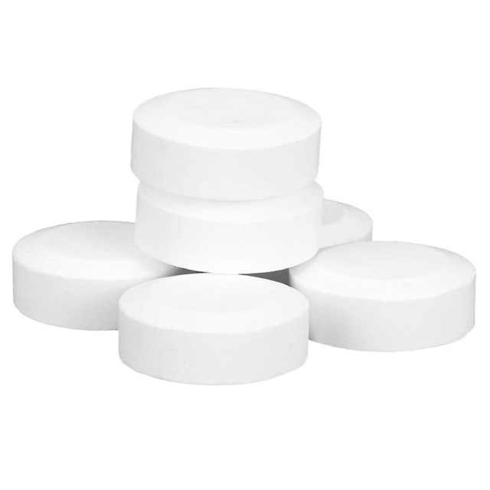
04
Product Introduction OEM Series
Name | Multi-purpose Cleaning Tablets |  | Commodity attributes: Car Wiper cleaning
Specification | 5 grams | 8 grams | Customizable: weight/ color/ content/ shape
Main Ingredient | Surfactant, citric acid, sodium bicarbonate
Effect | clean thoroughly
Instructions | Take one piece of this product and put it into the car wiper pot, fill the wiper pot with water, dissolve it for about 15 minutes and then use it.
Executive standard | Q\TLJ043-2021

Slide 7
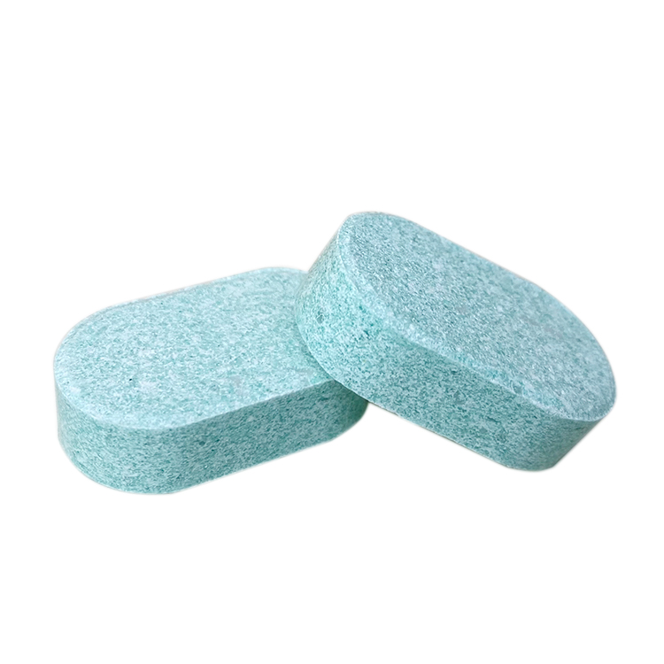
05
Product Introduction OEM Series
Name | Detergent Effervescent Tablet | Commodity attributes: household cleaning
Specification | 8 grams | Customizable: weight/ color/ content
Main Ingredient | Sodium Carbonate, Anhydrous Citric Acid, Surfactant, Preservative, Flavor Sodium Carbonate, Anhydrous Citric Acid, Surfactant, Preservative, Flavor
Effect | Rich foam, mild and non-irritating, with a delicate smell
Instructions | 1. Fill the spray bottle with pure water first (do not use tap water) 2. Then put an effervescent block in the spray bottle, and wait for the effervescent tablet to completely effervescently decompose 3. Finally, screw on the nozzle and press the pump head lightly to squeeze out an appropriate amount of foam, rub your hands thoroughly and rinse with water. (Note: 1 tablet mixed with 250ml water)
Executive standard | Q\TLJ0018-2021

Slide 8
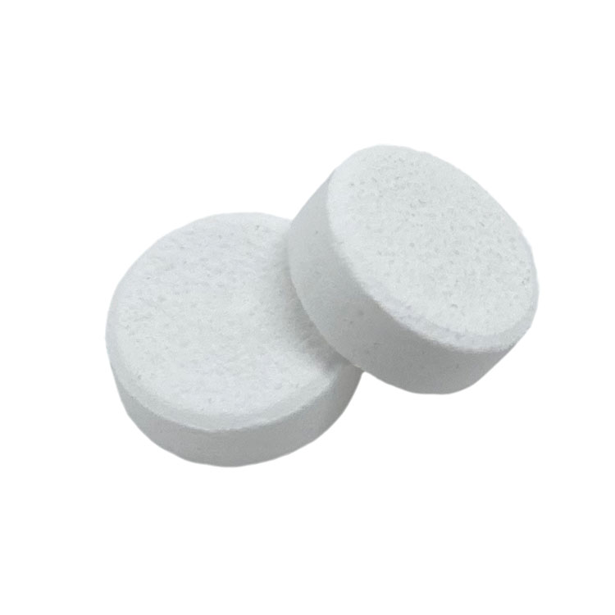
06
Product Introduction OEM Series
Name | Effervescent Tablets for Tea Scale Cleaning | Commodity attributes: household cleaning
Specification | 5 grams | Customizable: weight/ color/ content
Main Ingredient | Oxygen particles, sodium carbonate, soda ash, tartaric acid, CMC, TAED, PEG-6000 food grade imported, salt, etc.
Effect | Disintegrate dirt, biological enzymes, inhibit bacteria
Instructions | 1. Add an appropriate amount of this product into an open container 2. Add 60-100 degrees of hot water, 1 liter of water is about 20 grams (1-2 tablets per ordinary container) 3. There are a lot of bubbles, and the tea stains begin to dissolve 4. .After waiting for about 10 minutes, take out the item and rinse it with water. 4. Remember not to cover the lid. 5. This product is only suitable for glass, porcelain, pottery, plastic, stainless steel and other metals (except aluminum, silver, etc.)
Executive standard | Q\TLJ005-2020

Slide 9
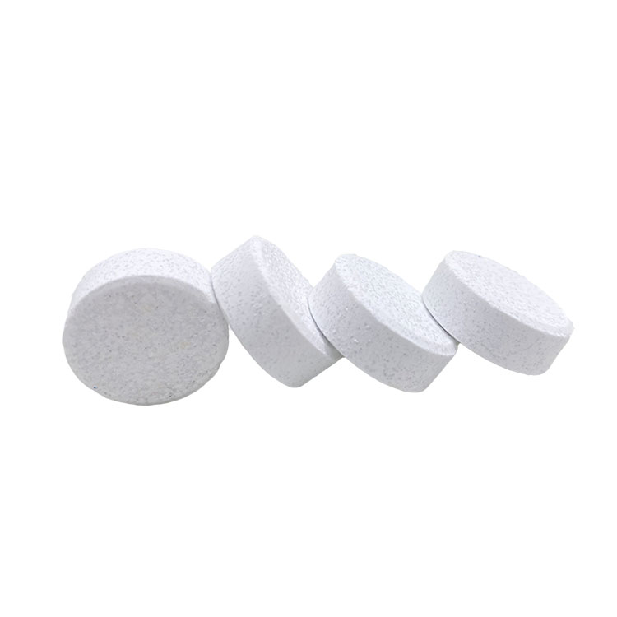
07
Product Introduction OEM Series
Name | Denture Cleaning Tablets | Commodity attributes: household cleaning
Specification | 3 gram | Customizable: weight/ color/ content
Main Ingredient | Bactericides, surfactants, sodium bicarbonate, sodium percarbonate, sodium tripolyphosphate
Effect | Antibacterial and stain removal, fresh breath
Instructions | 1. Rinse the retainer with clean water first. 2. Put a piece of cleaning tablet into warm water at about 40°C without stirring to ensure that the water in the cup can cover the holder 3. Put it in the retainer, it can remove the stains on the retainer in about 15 minutes, more stains need to be longer or soak overnight, the effect is better 4. Before putting on the retainer, wash it with clean water or a soft brush before putting it on

Slide 10
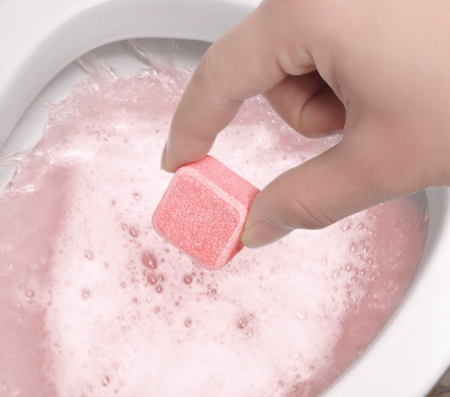
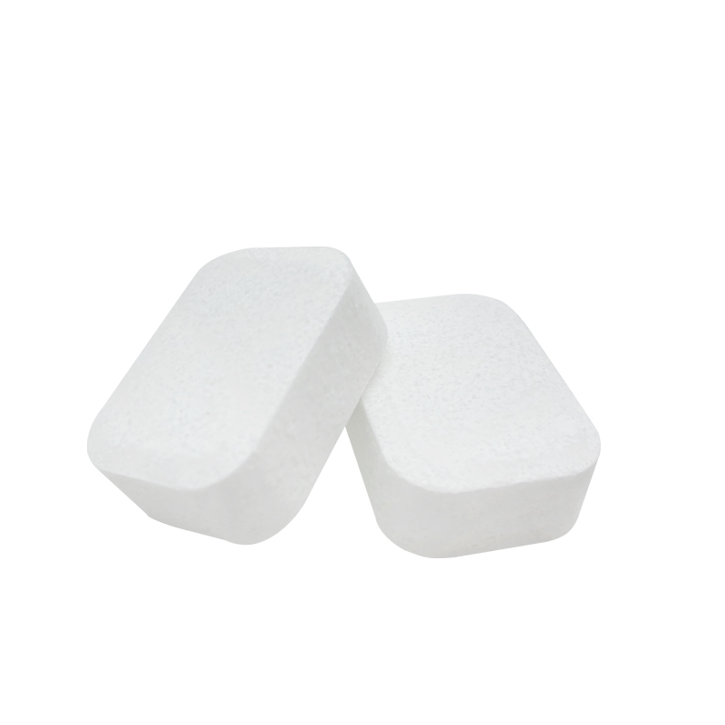
08
Product Introduction OEM Series
Name | Toilet Cleaning Tablet |  | Commodity attributes: household cleaning
Specification | 15 grams | 20 grams | Customizable: weight/ color/ content
Main Ingredient | Surfactant Rinse Agent
Effect | Strong decontamination, bactericidal and antibacterial, deodorizing and fragrant, not hurting the glaze
Instructions | 1. Open the package and remove the effervescent tablets 2. Put it directly into the toilet or water tank 3. Let stand for about 10 minutes, preferably overnight 4. Rinse with toilet brush

Slide 11
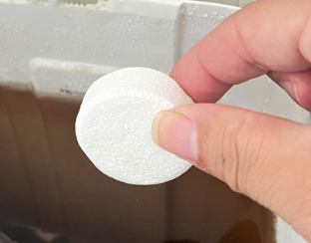
09
Product Introduction OEM Series
Name | Toilet Tank Cleaner (sustained release formula) |  | Commodity attributes: household cleaning - toilet cleaner
Specification | 15 grams | 20 grams | Customizable: weight/ color/ content
Main Ingredient | Bactericides, surfactants, slow-release agents, aromatic substances, calcium hypochlorite, etc.
Effect | Remove the dirt attached to toilets, sinks, water pipes, and urinals, and make the drains unobstructed, which can also remove stench and inhibit the growth of bacteria.
Instructions | 1. Take out a cleaning block 2. Put it into the corner of the water tank and keep it away from the water inlet and outlet to prolong the use time 3. Let the cleaning block dissolve completely 4. Flush the toilet

Slide 12

10
Product Introduction OEM Series
Name | Milk Stain Effervescent Tablet | Commodity attributes: household cleaning
Specification | 3 grams | Customizable: weight/ color/ content
Main Ingredient | Sodium percarbonate, anhydrous citric acid, protease, etc.
Effect | Pigment-free, phosphorus-free, plant-based, pure and mild, efficient decontamination, fresh and deodorant
Instructions | 1. Add more than 2/3 of the water to the bottle to be washed (no more than 60 degrees) 2. Put a bottle cleaning tablet and soak for 5-10 minutes 3. Shake it for about 10 seconds after soaking 4. Then rinse it with clean water
Executive standard | Q\TLJ017-2020

Slide 13
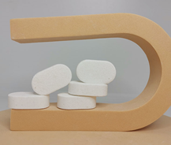
11
Product Introduction OEM Series
Name | Effervescent Hand Sanitizer |  | Commodity attributes: household cleaning
Specification | 5 grams | 8 grams | Customizable: weight/ color/ content
Main Ingredient | Sodium Lauroyl Glutamate, Sodium Olefin Sulfonate, Anhydrous Citric Acid, Sodium Lauryl Sulfate, Polyethylene Glycol, Sodium Carbonate, Aloe Vera Extract, Sodium Benzoate, Disodium EDTA, Glycerin
Effect | Suitable for hand cleaning, mild formula, rich foam, fragrant smell, quick cleansing without residue
Instructions | 1. Fill the spray bottle with pure water first. 2. Then place an effervescent block in the spray bottle and wait until the effervescent block is completely decomposed. 3. Finally, screw on the spray head, squeeze out a proper amount of foam on your hands, rub it and rinse it with water Just (1 tablet mixed with 250ML water)
Executive standard | GB\T34855-2017

Slide 14
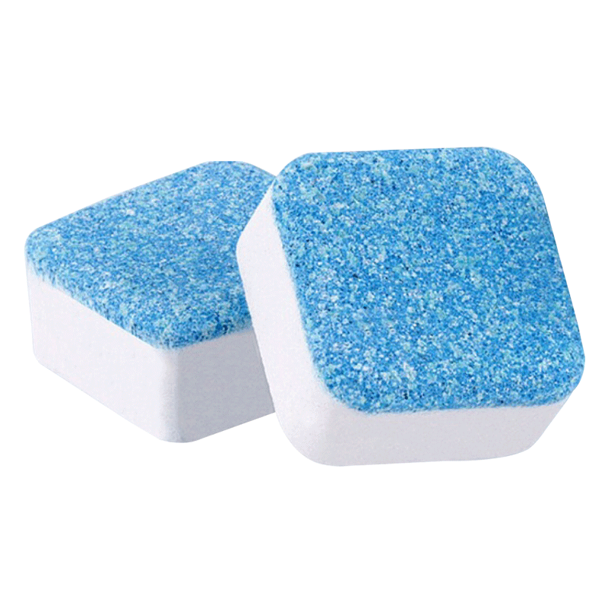
12
Product Introduction OEM Series
Name | Washing Machine Cleaning Effervescent Tablet |  | Commodity Attributes household Cleaning-Washing Machine Tank Cleaning Block
Specification | 15 grams | 20 grams | Customizable: weight/ color/ content
Main Ingredient | Peroxides, enzymes, surfactants, sodium bicarbonate, etc.
Effect | Disintegrate dirt, biological enzymes, inhibit bacteria
Instructions | Fully automatic washing machine: 1. It is recommended to use 6-8 pieces for the first time. According to the water level of the usual laundry, boil a pot of hot water into it, press pause after washing for 15 minutes, soak for 1-2 hours, and then press the washing mode to discharge Just sewage Drum washing machine: select the drum cleaning mode
Executive standard | Q\TLJ003-2020

Slide 15
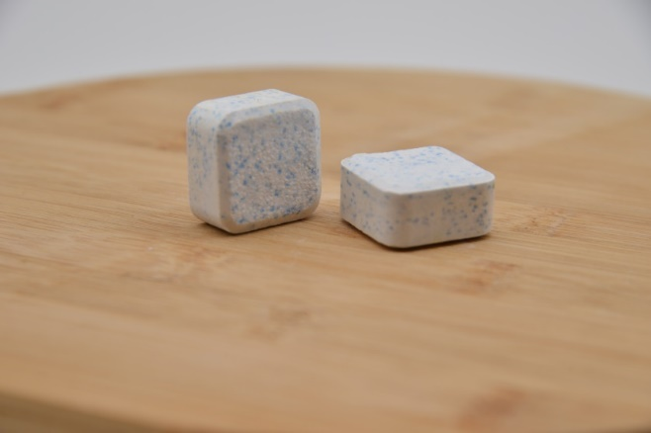
13
Product Introduction OEM Series
Name | Clothing Oxygen Color Bleach Effervescent Tablets | Commodity attributes: household cleaning
Specification | 15 grams | Customizable: weight/ color/ content
Main Ingredient | Oxidizing agent Reducing agent Surfactant Biological enzyme Citric acid etc.
Effect | Oxygen penetration, deep cleansing, brightening and color protection, mildew and yellow removal
Instructions | 1. Put this product into the basin according to the dosage 2. When the effervescence dissolves, put the clothes into the basin 3. Soak for 2-6 hours 4. If you are afraid of scalding clothes, soak them in water when the water temperature drops below 40°C
Executive standard | Q\TLJ005-2020

Slide 16
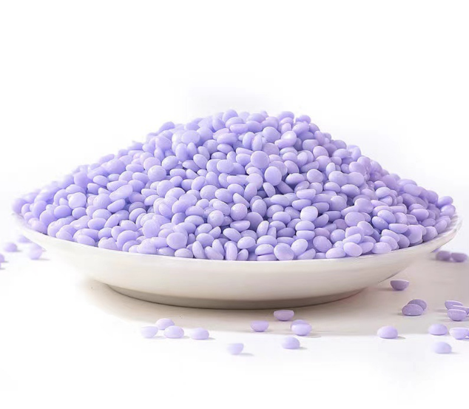
14
Product Introduction OEM Series
Name | Fragrance Beads | Commodity attributes: household cleaning
Specification | / | Customizable: weight/ color/ content
Color | Pink/yellow/purple/green/blue (customized)
Main Ingredient | Polyethylene glycol, essence, microcapsule fragrance
Effect | Soft fiber, anti-static, long-lasting fragrance
Instructions | Put the clothes into the washing machine together with this product, and the washing is finished
Executive standard | Q/TLJ005-2021

Slide 17
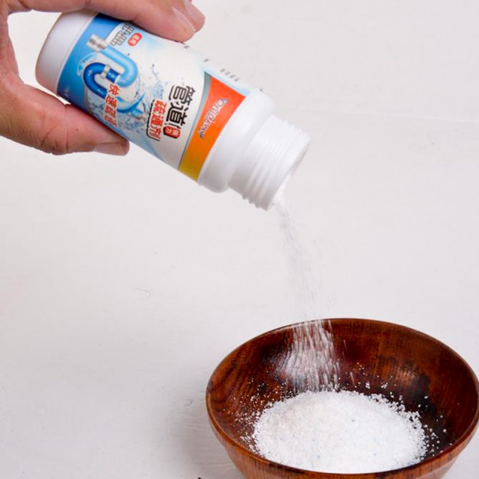
15
Product Introduction OEM Series
Name | Plumbing Agent | Commodity attributes: household cleaning
Specification | 100g/250g/350g | Customizable: weight
Main Ingredient | Sodium hydroxide, sodium percarbonate, foaming agent, etc.
Effect | Unclog pipes, deodorize and deodorize, decontaminate and sterilize
Instructions | Pour this product into the toilet to solve the clogging problem

Slide 18
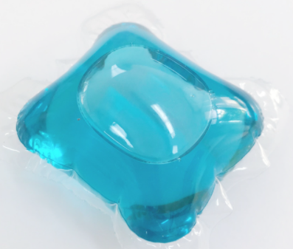
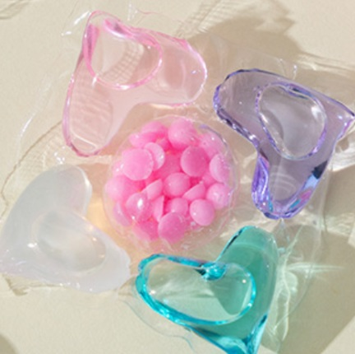
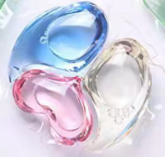
16
Product Introduction OEM Series
Name | Laundry Pods | Commodity attributes: household cleaning
Specification | 5g/8g/10g/15g | Customizable: weight/ color/ content
Shape | Single/ 2 in 1/ 3 in 1/ 5 in 1/ 6 in 1 Refillable fragrance beads
Main Ingredient | Surfactant, stabilizer, neutral agent, dispersant, clothing freshener, fragrance, protease, cellulase, amylase, etc.
Effect | Fragrant smell, soft and thick texture, mild in nature and not harmful to clothes, unique low-foam concentrated color-locking formula, easier to rinse, condensed beads dissolve in water without residue, and can effectively and quickly remove stubborn stains to make clothes clean as new
Instructions | 1. One laundry beads can clean 3-5 pieces of clothes 2. Take out the laundry beads: do not cut or tear the laundry beads 3. Put the laundry beads into the drum: do not put the laundry beads into the material box (the product may be stuck in the material box and block/block the running water) 4. Pour in the clothes to start the laundry process: the outer membrane of the laundry beads is soluble in water and there is no residue after washing.

Slide 19
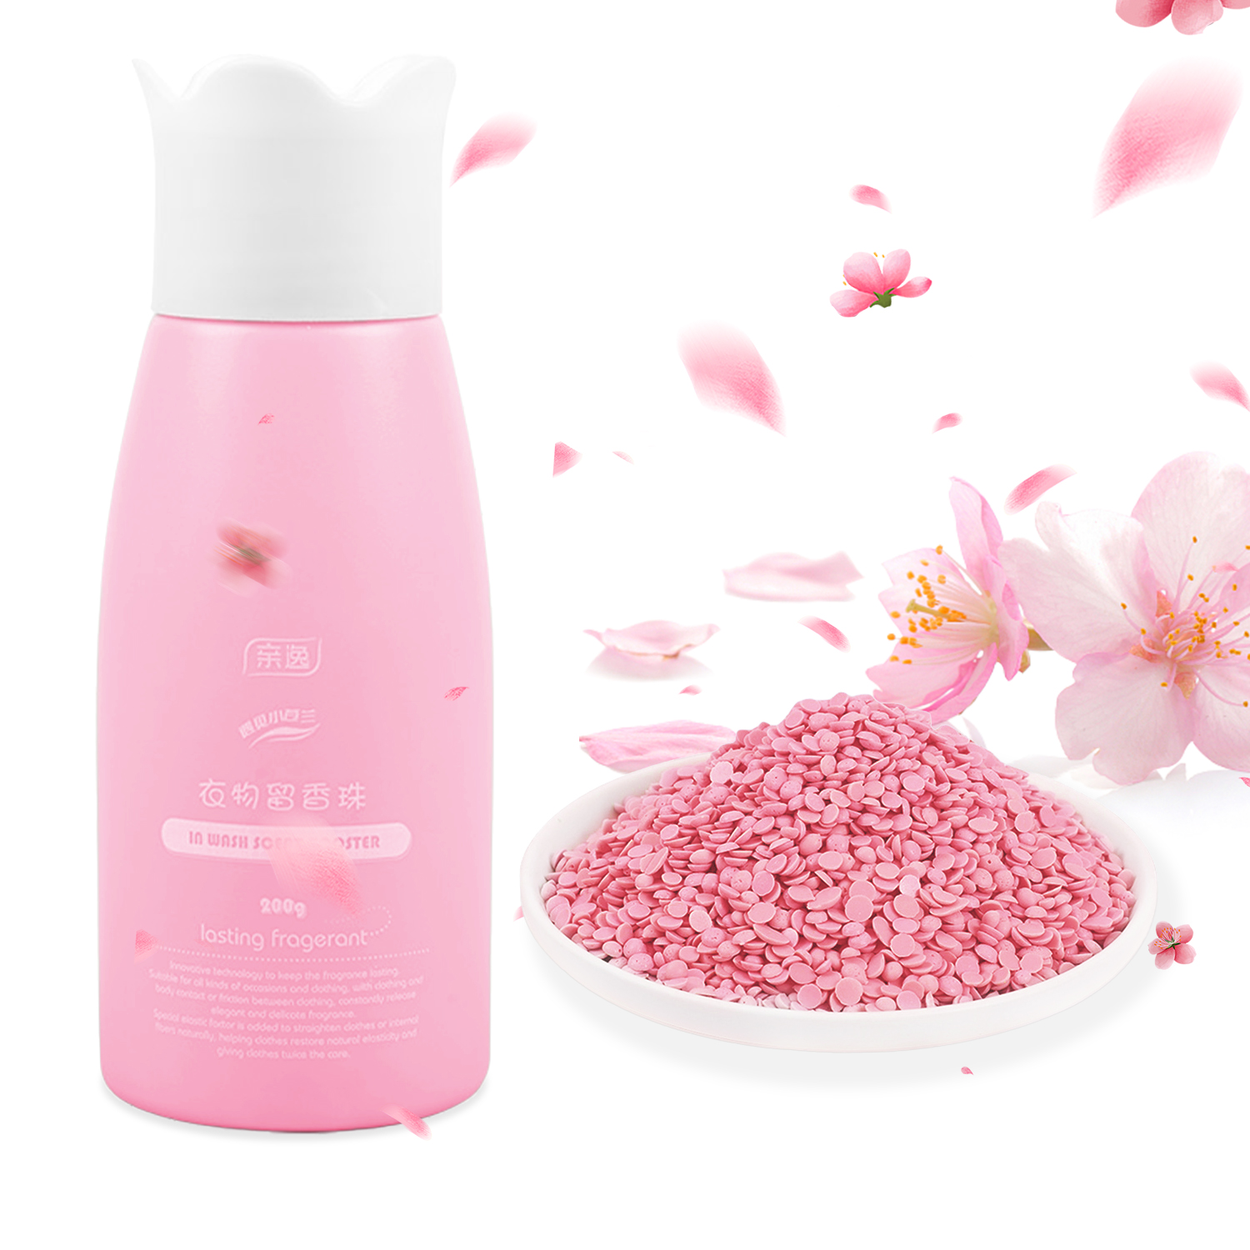
17
Product Introduction Pro-Easy Series
Name | Fragrance Beads | Commodity attributes: household cleaning
Specification | 200 grams/ bottle
Fragrance | Blue Campanula、 COCO、 Rose | Perfume2% Microcapsules2%
Main Ingredient | Polyethylene Glycol Fragrance Microcapsule Fragrance Mite Removal Factor
Effect | Soft clothes, long-lasting fragrance, removes mites.
Instructions | Open the bottle cap, pour the beads into the cap, take about 20-40g, if you want the clothes to be more fragrant, you can also add a little more, then pour them directly into the inner drum of the washing machine, and then put the clothes in. Finally, pour in an appropriate amount of laundry detergent or washing powder, and then start washing clothes.
Executive standard | Q/TLJ005-2021

Slide 20
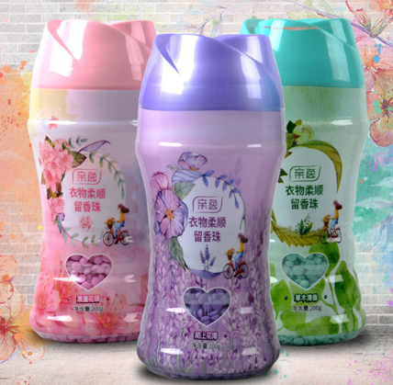
18
Product Introduction Pro-Easy Series
Name | Fragrance Beads | Commodity attributes: household cleaning
Specification | 200 grams/ Bottle
Fragrance | Blue Campanula、 COCO、 Rose | Perfume2% Microcapsules2%
Main Ingredient | Polyethylene Glycol Fragrance Microcapsule Fragrance Mite Removal Factor
Effect | Soft clothes, long-lasting fragrance, removes mites.
Instructions | Open the bottle cap, pour the beads into the cap, take about 20-40g, if you want the clothes to be more fragrant, you can also add a little more, then pour them directly into the inner drum of the washing machine, and then put the clothes in. Finally, pour in an appropriate amount of laundry detergent or washing powder, and then start washing clothes.
Executive standard | Q/TLJ005-2021

Slide 21
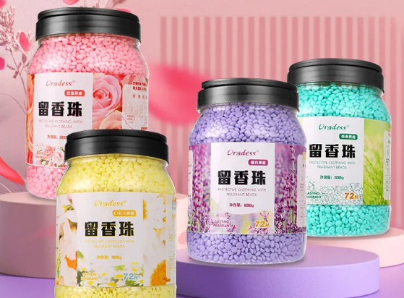
19
Product Introduction Pro-Easy Series
Name | Fragrance Beads | Commodity attributes: household cleaning
Specification | 800 grams/ bottle
Fragrance | Blue Campanula、 COCO、 Rose | Perfume2% Microcapsules2%
Main Ingredient | Polyethylene Glycol Fragrance Microcapsule Fragrance Mite Removal Factor
Effect | Soft clothes, long-lasting fragrance, removes mites.
Instructions | Open the bottle cap, pour the beads into the cap, take about 20-40g, if you want the clothes to be more fragrant, you can also add a little more, then pour them directly into the inner drum of the washing machine, and then put the clothes in. Finally, pour in an appropriate amount of laundry detergent or washing powder, and then start washing clothes.
Executive standard | Q/TLJ005-2021

Slide 22
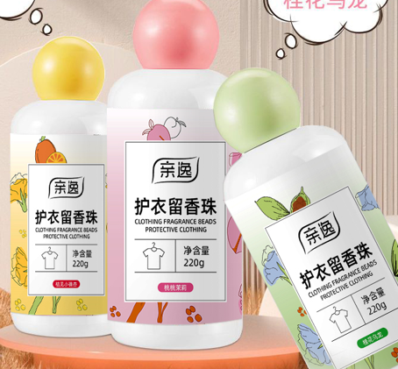
20
Product Introduction Pro-Easy Series
Fragrance Beads | Fragrance Beads | Commodity attributes: household cleaning
Specification | 200 grams/ bottle
Fragrance | Blue Campanula、 COCO、 Rose
Main Ingredient | urea、 Perfume
Effect | Fragrance
Instructions | Open the bottle cap, pour the beads into the cap, take about 20-40g, if you want the clothes to be more fragrant, you can also add a little more, then pour them directly into the inner drum of the washing machine, and then put the clothes in. Finally, pour in an appropriate amount of laundry detergent or washing powder, and then start washing clothes.
Executive standard | Q/TLJ005-2021

Slide 23
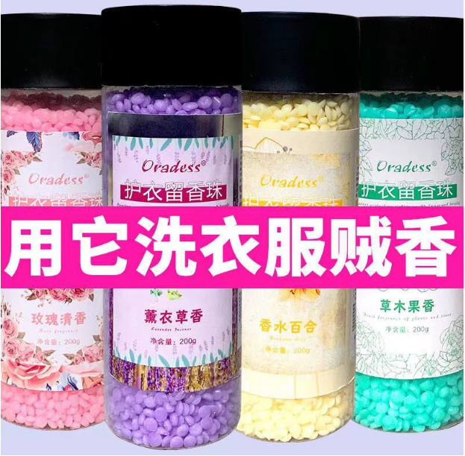
21
Product Introduction Pro-Easy Series
Name | Fragrance Beads | Commodity attributes: household cleaning
Specification | 200 grams/ bottle
Fragrance | Blue Campanula、 COCO、 Rose
Main Ingredient | urea、 Perfume
Effect | Fragrance
Instructions | Open the bottle cap, pour the beads into the cap, take about 20-40g, if you want the clothes to be more fragrant, you can also add a little more, then pour them directly into the inner drum of the washing machine, and then put the clothes in. Finally, pour in an appropriate amount of laundry detergent or washing powder, and then start washing clothes.
Executive standard | Q/TLJ005-2021

Slide 24
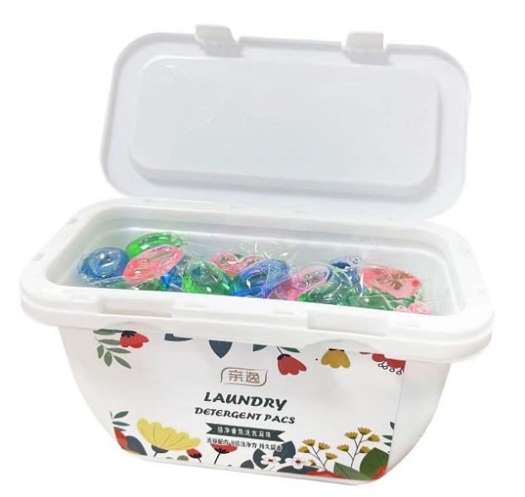
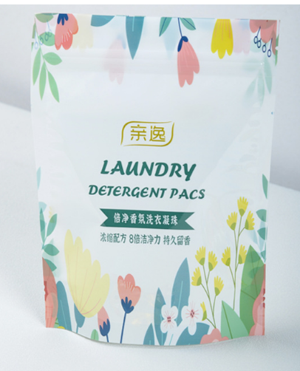
22
Product Introduction Pro-Easy Series
Name | 3 in 1 Laundry Pods | Commodity attributes: household cleaning
Specification | 30pcs/ box or 9 pcs/bag | Customizable body color/fragrance
Color | All
Main Ingredient | Surfactant, stabilizer, neutral agent, dispersant, clothing freshener, fragrance, protease, cellulase, amylase, etc.
Effect | Fragrant smell, soft and thick texture, mild in nature and not harmful to clothes, unique low-foam concentrated color-locking formula, easier to rinse, condensed beads dissolve in water without residue, and can effectively and quickly remove stubborn stains to make clothes clean as new
Instructions | 1. One laundry beads can clean 3-5 pieces of clothes 2. Take out the laundry beads: do not cut or tear the laundry beads 3. Put the laundry beads into the drum: do not put the laundry beads into the material box (the product may be stuck in the material box and block/block the running water) 4. Pour in the clothes to start the laundry process: the outer membrane of the laundry beads is soluble in water and there is no residue after washing.

Slide 25
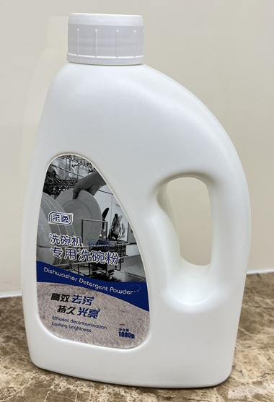
23
Product Introduction Pro-Easy Series
Name | Dishwasher Special Dishwasher Powder | Commodity attributes: household cleaning
Specification | 1KG
Color | Can be customized
Main Ingredient | Soda ash, sodium citrate, amino acid active agent, biological enzyme, etc.
Effect | Concentrated decontamination, water softening, bright tableware, odor removal, safe and no residue
Instructions | Refer to the dishwasher instructions

Slide 26
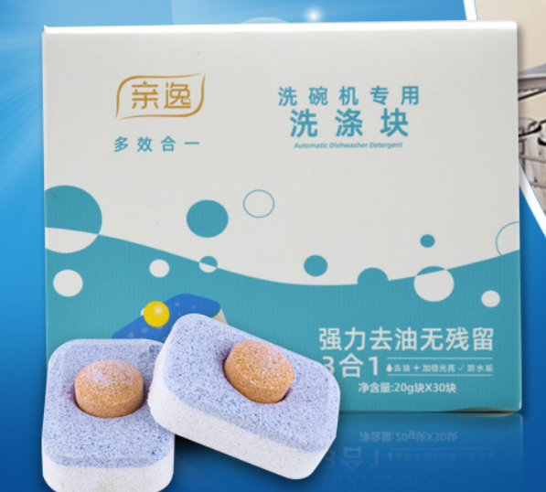
24
Product Introduction Pro-Easy Series
Name | Dishwasher Tablet | Commodity attributes: household cleaning
Specification | 20 grams/pc * 30 pcs | Customizable: weight/ color/ content
Color | Can be customized
Main Ingredient | Soda ash, sodium citrate, amino acid active agent, biological enzyme, etc.
Effect | Concentrated decontamination, water softening, bright tableware, odor removal, safe and no residue
Instructions | Refer to the dishwasher instructions

Slide 27
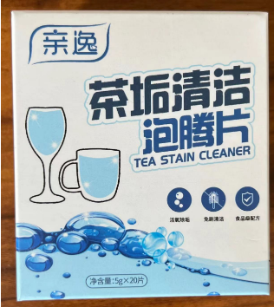
25
Product Introduction Pro-Easy Series
Name | Effervescent Tea Scale Cleansing Tablets | Commodity attributes: household cleaning
Specification | 5 grams/pc * 20pcs | Customizable: weight/ color/ content
Color | Can be customized
Main Ingredient | Oxygen particles, sodium carbonate, soda ash, tartaric acid, CMC, TAED, PEG-6000 food grade imported, salt, etc.
Effect | Clean tea cups, tea sets, feeding bottles and other containers
Instructions | 1. Add an appropriate amount of this product into an open container 2. Add 60-100 degrees of hot water, 1 liter of water is about 20 grams (1-2 tablets per ordinary container) 3. There are a lot of bubbles, and the tea stains begin to dissolve 4. .After waiting for about 10 minutes, take out the item and rinse it with water. 4. Remember not to cover the lid. 5. This product is only suitable for glass, porcelain, pottery, plastic, stainless steel and other metals (except aluminum, silver, etc.)

Slide 28
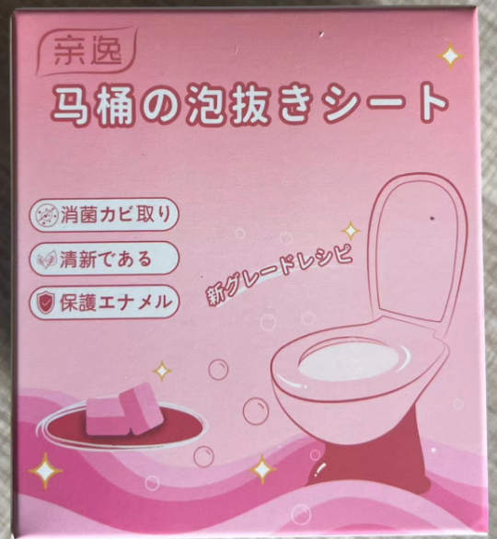
26
Product Introduction Pro-Easy Series
Name | Toilet Cleaning Effervescent Tablets | Commodity attributes: household cleaning
Specification | 15 grams/pc * 12pcs | Customizable: weight/ color/ content
Color | Can be customized
Main Ingredient | Surfactant Rinse Agent
Effect | Strong decontamination, bactericidal and antibacterial, deodorizing and fragrant, not hurting the glaze
Instructions | 1. Open the package and remove the effervescent tablets 2. Put it directly into the toilet or water tank 3. Let stand for about 10 minutes, preferably overnight 4. Rinse with the toilet brush

Slide 29
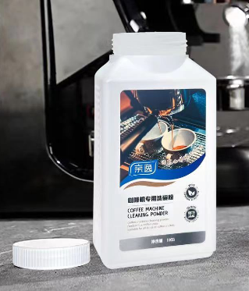
27
Product Introduction Pro-Easy Series
Name | Coffee Machine Cleaning Powder | Commodity attributes: household cleaning
Specification | 1KG | Customizable: weight/ color/ content
Color | White
Main Ingredient | Citric acid, sodium percarbonate, maleic acid, sulfamic acid
Effect | Clean the coffee grease, clean the brewer of the coffee machine, protect the internal pipeline of the coffee machine
Instructions | Refer to the instruction manual of each coffee machine

Slide 30
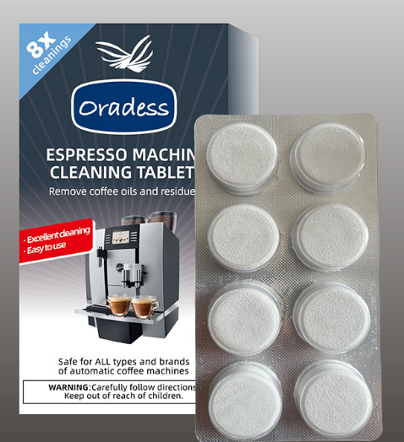
28
Product introduction Oradess trade series
Name | Coffee Machine Cleaning Tablets Aluminum Foil Tablet Packaging |  | Commodity attributes: household cleaning
Specification | 5 grams * 8pcs | 2 grams * 10pcs | Customizable: weight/ color/ content
Color | Can be customized
Main Ingredient | Citric acid, sodium percarbonate, maleic acid, sulfamic acid
Effect | Clean the coffee grease, clean the brewer of the coffee machine, protect the internal pipeline of the coffee machine
Instructions | Refer to the instruction manual of each coffee machine

Slide 31
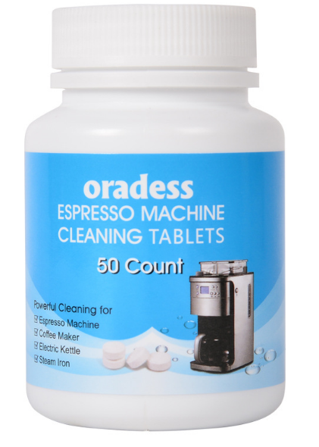
29
Product introduction Oradess trade series
Name | Bottled Coffee Machine Cleaning Tablets |  | Commodity attributes: household cleaning
Specification | 2 grams*25pcs | 2 grams * 50pcs | Customizable: weight/ color/ content
Color | White
Main Ingredient | Citric acid, sodium percarbonate, maleic acid, sulfamic acid
Effect | Clean the coffee grease, clean the brewer of the coffee machine, protect the internal pipeline of the coffee machine
Instructions | Refer to the instruction manual of each coffee machine

Slide 32
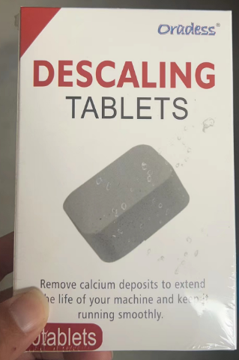
30
Product introduction Oradess trade series
Name | Descaling Effervescent Tablet Box Packed | Commodity attributes: household cleaning
Specification | 15 grams * 10pcs | Customizable: weight/ color/ content
Color | White
Main Ingredient | Citric Acid, Soda Ash, Sodium Percarbonate, Maleic Acid, Sodium Tripolyphosphate
Effect | Clean the scale of containers such as coffee machines, thermos cups, electric irons, and kettles
Instructions | 1. Add an appropriate amount of this product to an open container 2. Add an appropriate amount of water, 1 liter of water is about 20 grams (1-2 tablets each time in an ordinary container) 3. A large number of bubbles are generated, and the scale begins to dissolve 4. Wait for about 10 minutes Finally, take out the item and rinse it with water. 4. Remember not to cover it. 5. This product is only suitable for glass, porcelain, pottery, plastic, stainless steel and other metals.

Slide 33
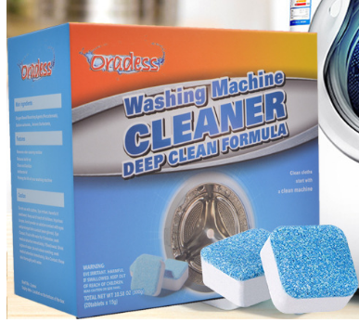
31
Product introduction Oradess trade series
Name | Washing Machine Cleaning Effervescent Tablet |  | Commodity attributes: household cleaning
Specification | 15 grams * 12pcs | 15g grams * 30pcs | Customizable: weight/ color/ content
Color | Can be customized
Main Ingredient | Active agents, percarbonic acid, enzymes, organic acids
Effect | Disintegrate dirt, clean the inner wall of the washing machine, and sterilize
Instructions | Fully automatic washing machine: 1. It is recommended to use 6-8 pieces for the first time. According to the water level of the usual laundry, boil a pot of hot water into it, press pause after washing for 15 minutes, soak for 1-2 hours, and then press the washing mode to discharge Just sewage Drum washing machine: select the drum cleaning mode

Slide 34
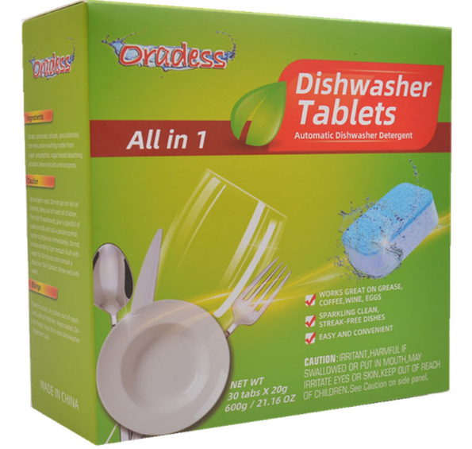
32
Product introduction Oradess trade series
Name | Dishwasher special dishwashing Tablets | Commodity attributes: household cleaning
Specification | 20 grams * 30pcs | Customizable: weight/ color/ content
Main Ingredient | Soda ash, sodium citrate, amino acid active agent, biological enzyme, etc.
Effect | Concentrated decontamination, water softening, bright tableware, odor removal, safe and no residue
Instructions | Refer to the instruction manual of each brand of dishwasher

Slide 35
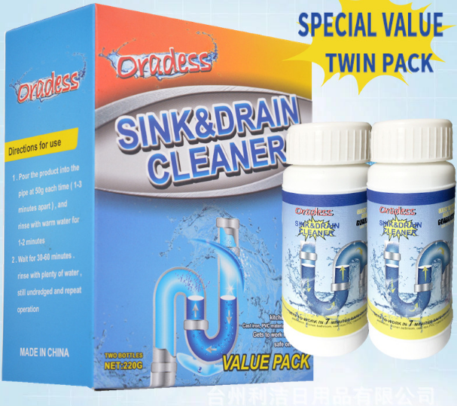
33
Product introduction Oradess trade series
Name | Plumbing Agent | Commodity attributes: household cleaning
Specification | 110 grams/ bottle | Customizable: weight/ color
Color | White
Main Ingredient | Sodium hydroxide, sodium percarbonate, foaming agent, etc.
Effect | Unclog pipes, deodorize and deodorize, decontaminate and sterilize
Instructions | 1. The toilet is blocked and the water is very slow. 2. Pour one bottle at the entrance, and then add about 1 kg of water, so that the product will slowly penetrate into the blocked position after fully dissolving. 3. When the water level is lowered, add an appropriate amount of water, and push the solution solution to the position where the pipe is blocked. After 1 hour, flush with a large amount of water and it will be unblocked.

